Slide 1


Transgenerational Epigenetic Inheritance of Diet Induced Metabolic Perturbations in Drosophila
Manoj R. Teltumbade
Supervisor: Dr. Abhay Sharma
Notes:
I will first explain what is epigenetic inheritance, why should it be transgenerational.
Then its relation to common diseases. And finally how I am modelling it in our lab to understand mechanisms by which it is related to those diseases.

Slide 2
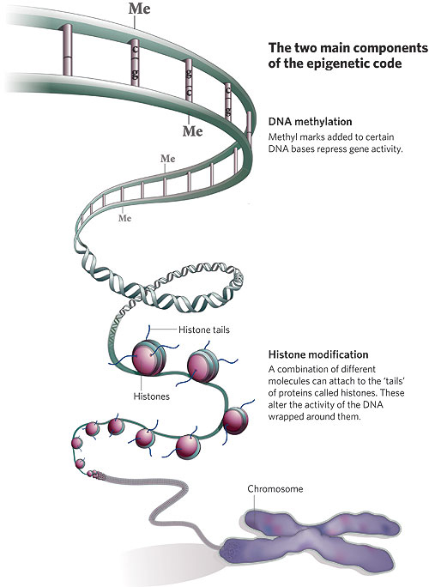
What are Epigenetic changes?
“Heritable changes that do not involve changes in the underlying DNA sequences”
Qiu J. Epigenetics: unfinished symphony. Nature. 2006
Notes:
Epigenetic changes are heritable changes in gene expression, physiology or behaviour that do not involve mutations in the DNA sequence. There are two known mechanisms of these: methylation and histone acetylation. But there may be other mechanisms.

Slide 3
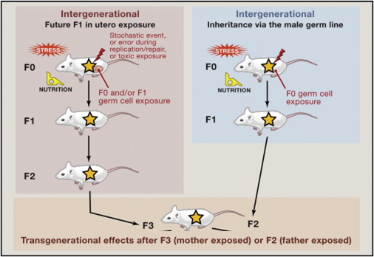
How to prove that a change is epigenetic and heritable?
Adapted from Edith Heard and Robert Martienssen. (2014) Cell.
Notes:
If an environmental feature induces a change that persists even after the inducer is removed then it is probably an epigenetic change. But how many generations should the change persist for? If females were exposed to the inducer then the change should persist for at least three generations, if males were exposed then the change should persist for at least two generations.
This will become more clear with an example of a case that was published in nature medicine.
In scheme one, we expose only the females, but the oocytes they harbour also get exposed, so F1 if affected; the oocyte will also produce the germ cells that give rise to F2, so F2 is also affected. Thus we will have to follow up to at least F3 after the removal of the inducer to confirm stable epigentic inheritance.

Slide 4
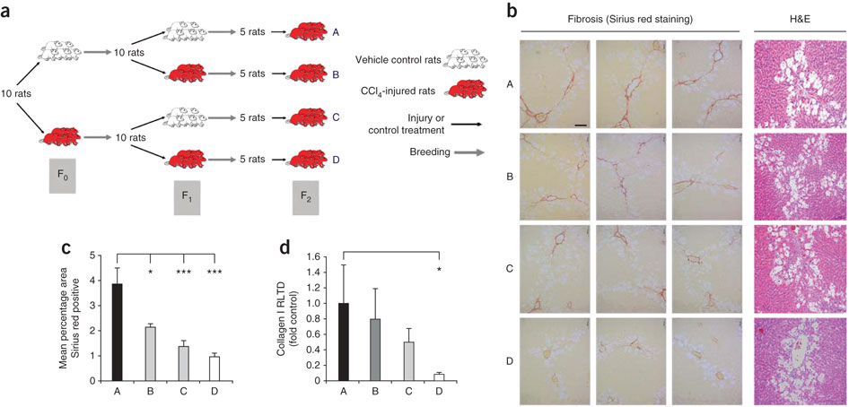
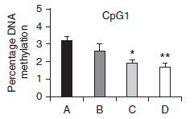

Transgenerational Epigenetic Inheritance Example I
PPARγ Promoter
Hepatic wounding
Sirius red staining
Fibrosis
Hypomethylation of PPAR-α gene promoter supported a role for DNA methylation in the adaptive process
Zeybel, M. et al. (2012) Multigenerational epigenetic adaptation of the hepatic wound-healing response. Nature Med.
Notes:
Adaptive liver healing in mice whose ancestors were exposed to chloroform.
The inducer—chloroform—wounds the liver of mice in F0, no exposure to chloroform takes place in F1 and when the authors again exposed the mice in F2 their livers healed faster and showed less scarring than mice whose ancestors were never exposed.

Slide 5

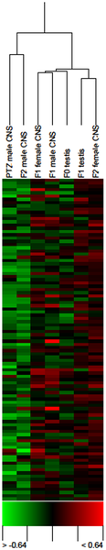
Transgenerational Epigenetic Inheritance Example II
Normal Female
F1 Male
F2 Male
P0
PTZ treated Male
No PTZ exposure
Gene Expression Profile
Sharma A, Singh P (2009) Detection of Transgenerational Spermatogenic Inheritance of Adult Male Acquired CNS Gene Expression Characteristics Using a Drosophila Systems Model. PlosOne

Slide 6
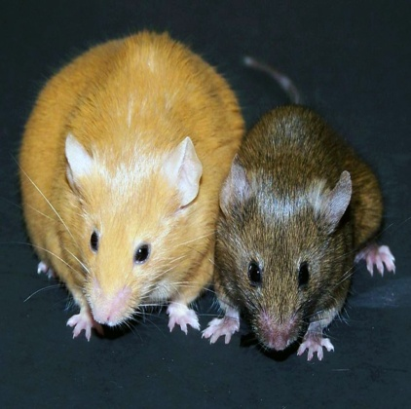
Importance of studying TEI
Epigenetic modifications play a critical role in the regulation of gene expression and contribution to the determination of a phenotype.
Increasing evidences indicate that the environment can stably influence the establishment of a heritable epigenome (GXE).
Q Can such epigenetic memory explain a proportion of missing heritability in complex diseases?
Germ-line epigenetic modification of the murine A^{vy} allele by nutritional supplementation. (Jennifer E. Cropley et al. 2006 PNAS)
Human: Response to nutrition, early life circumstances and longevity
(ye eg muje mil nahi raha tu daal de)
Epigenetic changes through various nutrition supplements can provide important clues into heretability of a metabolic phenotype , but exact mechanisms are unknown
Notes:
The concept that ancestral stress, particularly during gestation, may influence disease etiology for generations to come is an important aspect to consider in regards to our environment and society.

Slide 7
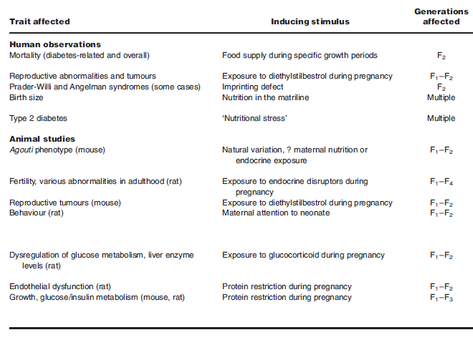
Metabolic Diseases in mammals show transgenerational epigenetic inheritance
But what is the mechanism?
Notes:
Reports suggest that RNA may be the carrier for epigenetic changes from one generation to the next.

Slide 8

Approach for discovering mechanism of epigenetic inheritance using flies
High-Sugar(HS) Diet
Control Diet
1. Does high-sugar diet perturb metabolism?
2. Does the perturbation persist?
F1
3. Test for involvement of germinal RNA.
F2
Notes:
To test if paternal RNA inherited from the sperm is indeed involved I have embarked on a three step plan:
Use a high sugar diet—the environmental inducer which is present in only the first generation just like chloroform in my first example and PTZ in my second example—to check if the exposed flies develop metabolic abnormalities.
2. Test for the stable inheritance of metabolic abnormalities even after the inducer is removed.
3. Test for contribution of paternal germinal RNA to transgenerational epigenetic inheritance

Slide 9
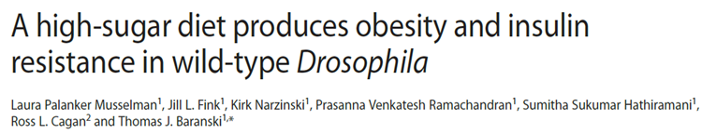

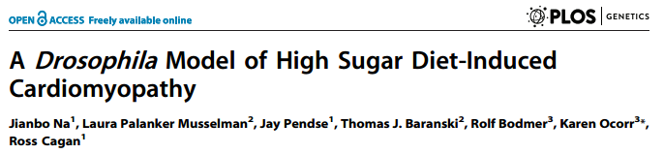

1. Does high-sugar diet perturb metabolism?
Drosophila as a model for metabolic perturbations !
Notes:
Two big labs already established Drosophila as a model for studying metabolic disorders even before I started.

Slide 10

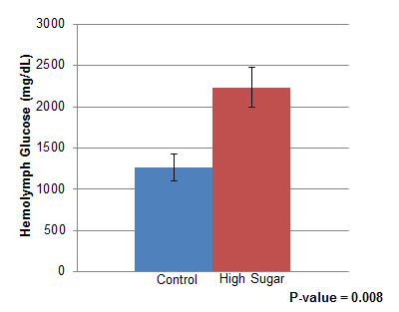
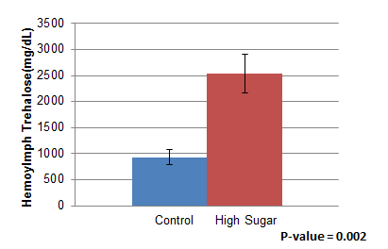
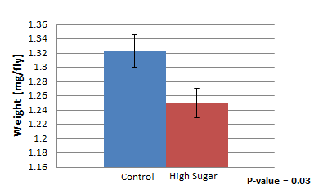
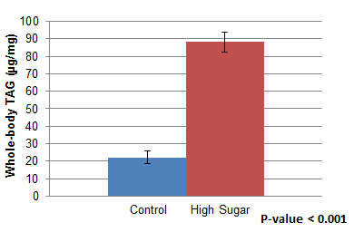
1. Does high-sugar diet perturb metabolism?
Hemolymph Glucose
Hemolymph Trehalose
High Sugar
Control
2 weeks
Whole body TAG
Isolate hemolymph from
decapitated flies
Whole body TAG
Weight
Measure :
Hemolymph Glucose
Hemolymph Trehalose
Weight
A high sugar diet can result in significant metabolic perturbations in Drosophila
Notes:
My first task in the lab was to replicate the authors’ work, and other than assaying insulin resistance in the flies I could show significant increases in the levels of circulating glucose, trehalose and triglyceride. We measure circulating levels by isolating the hemolymph—the fly equivalent to blood.
In line with previously published work my flies also show a decrease in weight there could be many reasons for it: insulin controls growth in flies and does not have separate growth factors. But as long as the change is heritable the direction does not matter.

Slide 11
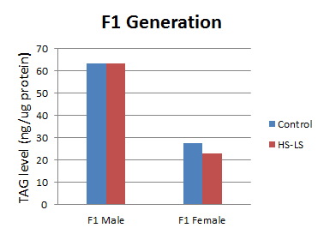


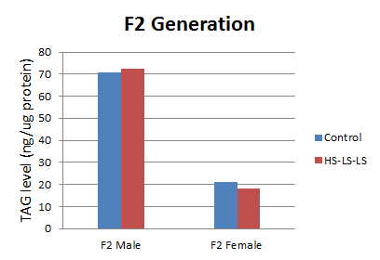
2. Do the metabolic perturbations persist across generations?
Whole Body TAG measurement
High Sugar Diet
Normal Diet
Normal Diet
F0
F1
F2
2 weeks
Whole body TAG
Isolate haemolymph from decapitated flies
Measure :
Haemolymph Glucose
Haemolymph Trehalose
Weight
Notes:
Which brings me to the second step of my plan. That is, demonstrating that the metabolic perturbations got inherited by the second and third generations even though they were reared on normal diet.

Slide 12
3. Test for involvement of paternal RNA.
Label sperm RNA and check its presence in the fertilized oocyte
Inject sperm RNAs from high-sugar fed males into fertilized wild-type oocytes
Purify and profile labeled sperm RNA to identify most important candidates for a misexpression screen.
Notes:
The final step of my plan is to confirm the hypothesis that it is RNA present in the male sperm which carries the epigenetic information through generations.

Slide 13
Test for involvement of germinal RNA.
Notes:
To test if RNA present in the sperm of males could be the carrier of epigenetic information I would label it by testis-restricted uracil phosphoribosyltransferase (UPRT) expression which replaces the uracil in the cell with thiouracil. If the inheritance of RNA from sperm into the egg is confirmed then I will extract RNA from the sperm of high-fed sugar males and inject it into the oocyte of unexposed F0, F1, F2 females to check for the development of metabolic perturbation.
I will simultaneously profile the labeled sperm RNA to identify the most highly expressed genes to check if their knockdown using the UAS/GAL4 system remedies the metabolic perturbations.

Slide 14


Acknowledgement
Supervisor
Dr. Abhay Sharma
DAC Members
Dr. Dwaipayan Bharadwaj
Dr. Shantanu Sengupta
Dr. Sridhar Sivasubbu
Lab members
Ameek, Karunakar, Prashant & Arif
IGIB friends and Batchmates

Slide 15

Notes:
Doubt the conventional wisdom unless you can verify it with reason and experiment.

Slide 16
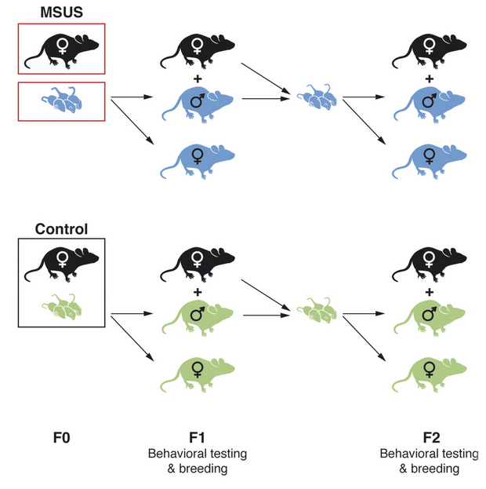
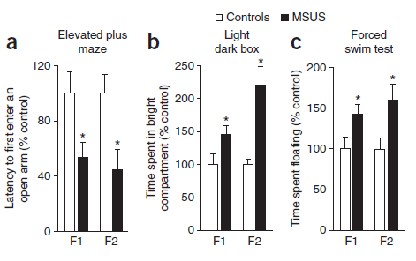
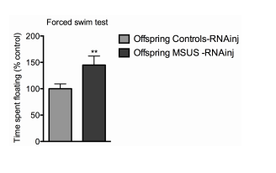
RNA-dependent processes may cause Transgenerational Inheritance
Notes:
Reduced Avoidance & Fear, altered response to aversive conditions (prefers the bright compartment), test for behaviour despair (spent more time correlates with loss of hope)

Slide 17
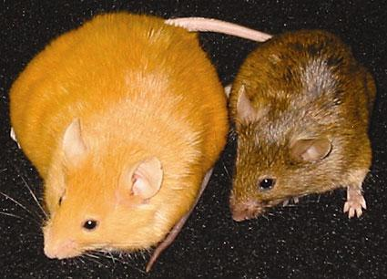
Waterland RA, Jirtle RL (2003) Mol Cell Biol

Slide 18
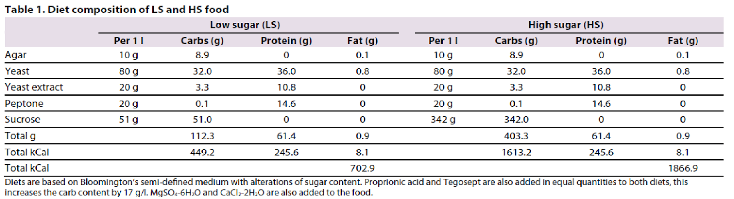
Diet composition of LS and HS diet

Slide 19








 | Stage | Time | Developmental events
 | 1- 4 | 0:00 - 2:10 h | Cleavage
 | 5 | 2:10 - 2:50 h | Blastoderm
 | 6 - 7 | 2:50 - 3:10 h | Gastrulation
 | 8 - 11 | 3:10 - 7:20 h | Germ band elongation
 | 12 - 13 | 7:20 - 10:20 h | Germ band retraction
 | 14 - 15 | 10:20 - 13:00 h | Head involution and dorsal closure
 | 16 - 17 | 13:00 - 22:00 h | Differentiation

Slide 20
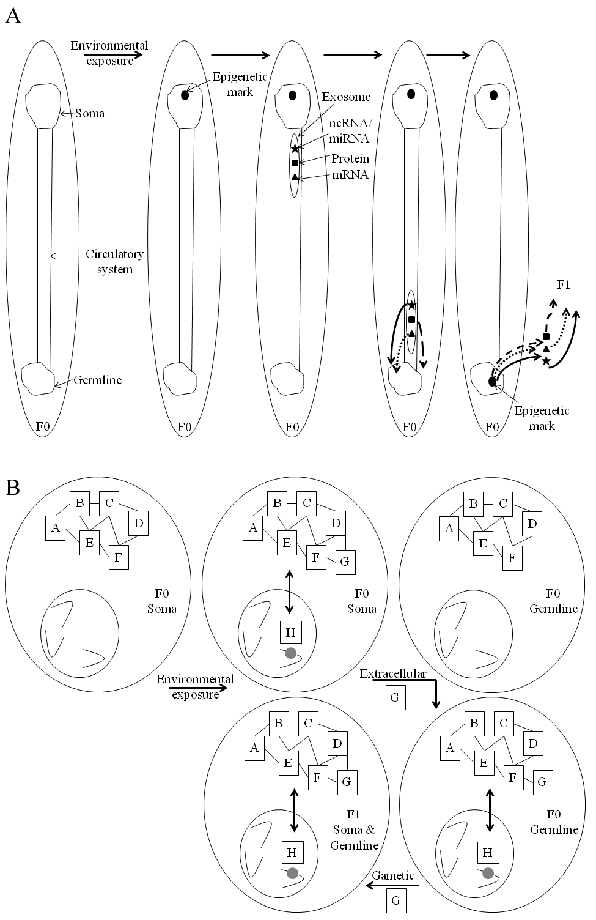
Fig. 4. Transgenerational systems biology. A model is shown to explain epigenetic inheritance at organismal (A) and cellular (B) levels. In the former, extracellular RNAs and proteins carry epigenetic information from soma to the germline. Curve arrows indicate direct information transfer (solid) or indirect transfer through first degree interactors (dashed) and second degree interactors (dotted). At cellular level, environmental exposure perturbs a biological process or pathway and leads to epigenetic modification; G and H represent these alterations, in that order. Extracellular G released from soma causes similar alterations in the germline. Gamete borne G causes process/pathway perturbation and epigenetic modification in the next generation. As both these altered states interact with each other, extracellular and/or gamete borne H can also theoretically transmit the signal.

Slide 21
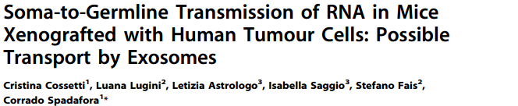

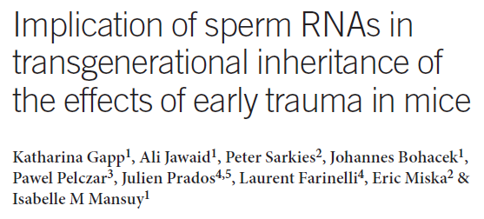
C. Cossetti et al., (2014) “Soma-to-germline transmission of RNA in mice xenografted with human tumour cells: possible transport by exosomes,” PloS one
High-sugar (HS) fed flies shows:
Triacylglycerides level
Circulating trehalose and glucose
Body weight

Slide 22
External Expert:
Prof. Dr. Namita Agrawal
DAC Committee:
Dr. Dwaipayan Bharadwaj
Dr. Shantanu Sengupta
Dr. Sridhar Sivasubbu

